Slide 1


Linux
File System and Navigation

Slide 2
The File System
Can contain all ascii characters except "/", however, many characters can create difficulties for the parser. starting a file name with hyphen '-', and characters such as "?, *, (, ), &, [, ], <, >, space and tab" all have special meaning on a CLI.
UNIX file names do not have extensions (.something), although naming conventions do exist
Dots are treated as literal characters. Although files that begin with a dot are special, and are hidden from ls unless -a is used.
A file name must be 255 chars or less.
On very old systems the maximum length for a filename is 14 characters!

Slide 3
Linux Directories
the root of the entire filesystem
/
bin
etc
tmp
home
var
sbin
dev
boot
usr
proc
root
default
fred
cash
block
bin
user binaries
cron.d
local
admin binaries
cpu
system snapshot in memory
laura
lib64
init
log
disk
sbin
network
pts
home directories
mail
share
systemd
usb
home directory for user ‘root’
spool
src
udev
null
tmp
…
passwd
…
…
spool and log files
kernels & boot files
system configuration files
system configuration files

Slide 4
Linux Directories
/bin essential binary programs to system operation
/etc system configuration files and some system executables
/tmp temporary directory; used by host of utilities, such as pg, vi, etc
/home user accounts (home directories)
/var volatile information used for spool files, logs, requests, mail, etc.
/sbin system bin, mostly admin executables
/dev the devices directory containing 'special' files, referring to all devices
/proc virtual filesystem in memory, with the kernel, processes, etc state
/boot a directory with Linux kernel(s) and boot configuration files
/usr user related programs and libraries

Slide 5
Directories from Lower Levels
/etc/default system default files, with default parameters for several commands
/etc/init master startup scripts (not used as part of startup configuration)
/etc/rc*.d run-level startup config scripts, links to files in the /etc/init.d directory
/usr/bin ‘user’ programs; /bin may be a symbolic link pointing here
/usr/include ‘C’ programs’ header files
/usr/lib library files (run time, shared, etc.)
/usr/lib64 as above, for 64-bit systems
/usr/share information shared read-only on a network (e.g. manual pages)
/usr/sbin system bin, mostly admin executables; /sbin may be a symbolic link pointing here
/usr/src source code for compilations

Slide 6
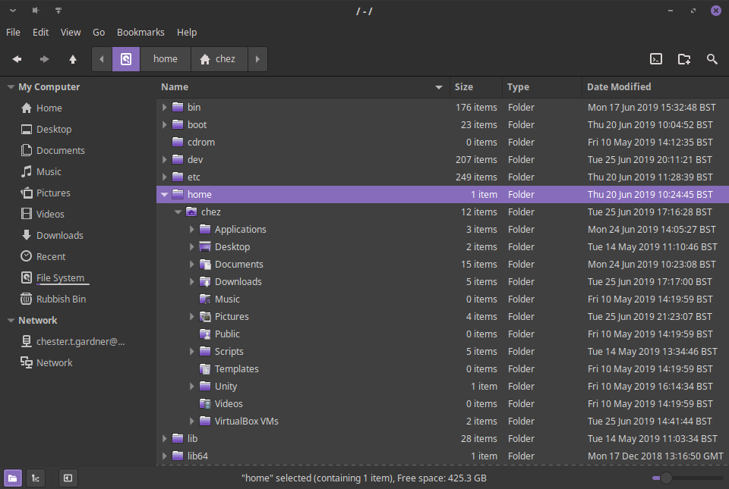
/home
Every user has a 'home directory', which has a number of uses.
It is the current directory when a user signs in to an interactive shell, and it stores user specific configuration files.
The names of the configuration files depend
on the applications in use, but usually start
with a dot, and thus, are hidden.
Normally a user's files will reside in their
home directory, but any other directory may
be used provided the user has sufficient
permissions.
The home directory contents is normally
protected from other users, although this
limitation does not apply to the super user.

Slide 7
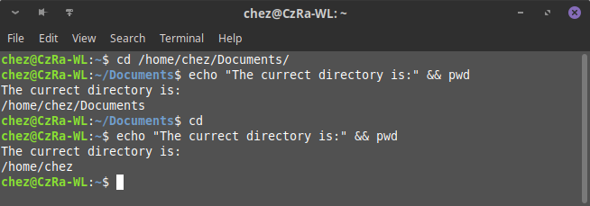
Changing Directories
Every task running on Linux on our behalf has a current working directory. When we first login to a shell this is the user's home directory, and our tasks 'inherit' this location.
But of course we often want to move elsewhere
To achieve this, we use the cd command to.
When used without an argument, cd places
the user in their home directory.

Slide 8
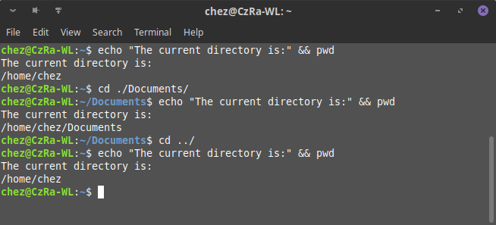
. and ..
Every directory in the Linux file system has two special entries, with names “.” and “..”. These are shorthand ways of referring to:
. is “this directory”
.. is “the parent of this directory”
These names can be used anywhere in a pathname, relative or absolute. They are of most use in relative pathnames, since they allow us to specify paths that traverse upwards through the hierarchy as well as downwards.

Slide 9
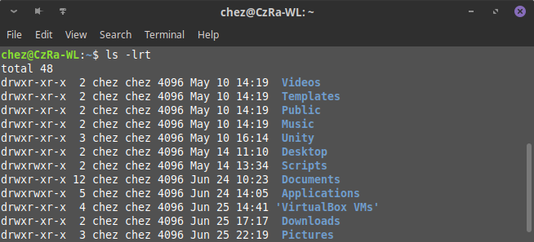
Listing Directories – ls
Number of Hard Links
Size in Bytes
File or Folder Name
Last Modified Date and Time
Permissions
User and Group

Slide 10
Permissions
Above are the permissions that are allowed for a file.
The first character denotes whether the file is a file (-), a directory (d) or a link (l)
The remaining characters determines whether the user, group and others (those that aren’t the user or in the group) can interact with the file.
Character 2, 3, and 4 are the user bits
Character 5, 6 and 7 are the group bits
Character 8, 9 and 10 are the other bits
r – whether the user, group or other can read the file or directory
w – whether the user, group or other can write to the file or directory
x – whether the user, group or other can execute the file or directory

Slide 11
inodes
An inode number points to an inode. An inode is a data structure that stores the following information about a file:
Size of file
Device ID
User ID of the file
Group ID of the file
The file mode information and access privileges for owner, group and others
File protection flags
The timestamps for file creation, modification etc
Link counter to determine the number of hard links
Pointers to the blocks storing file’s contents

Slide 12
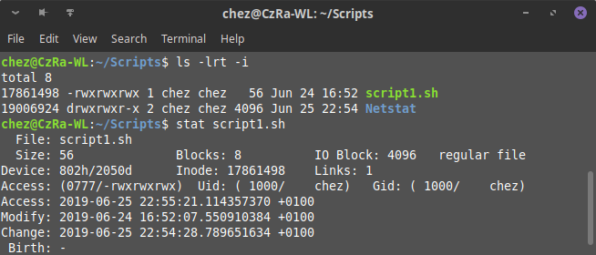
Finding the inode
You are able to identify the inode of a file or folder by applying the -i argument to the ls command
Using the stat command on a file or folder, you can see the inode number, as well as all three timestamps, which are maintained for each file and directory, and stored with the inode number
Access time stores when the file was last opened for reading.
Modification time shows when the contents of the file was last changed.
Change time relates to the i-node change (not the content of the file). This attribute records when the file attributes are modified, for example, file owner, or permissions

Slide 13
Links
data blocks
All UNIX filesystems, including those used in Linux, implement the concept of a link, which mean that several names can be associated with one i-node.
A link is an entry in the directory, which points to an already existing inode.
When a link is deleted, the kernel decrements the links count and de-allocates the inode if this count becomes zero.
directory
i-node table
file1
136220
hard links
i-node
data
file2
symbolic link
file3
136324
file1

Slide 14
Hard and Symbolic Link
A hard link is a direct pointer to the inode of the original file.
Linux filesystems provide an alternative to a hard link: a symbolic link, which is simply a file, which contains a filename.
Since a symbolic link does not point to an i-node, it is possible to create cross-filesystems symbolic links.
Symbolic links can point to any type of file, even to non-existent files.

Slide 15
Handling links
Use ls -i command to identify file i-node number
Remove links with rm; a file is deleted when the last hard link is removed
ln source target - for hard link
ln -s source … directory - for symbolic link
$ ln file1 file2
$ ln -s file1 file3
$ ls -il file[1-3]
77642 -rw-r--r-- 2 laura other 243 ... file1
77642 -rw-r--r-- 2 laura other 243 ... file2
77645 lrwxrwxrwx 1 laura other 5 ... file3 --> file1
$ ls -ilL file3
77642 -rw-r--r-- 2 laura other 243 ... file3
file being linked-to must exist (here: file1)
Notes:
The example illustrates the creation of two link files: a hard link, and a symbolic link.
Hard link is just another name pointing at the same i-node entry as the original filename. The moment the hard link has been created, the idea of an original and new name ceases to exist. Both names have the same 'power', and both names can be used to perform all allowed operations on the file. However, neither of the names can be moved into a different filesystem without destroying the link between them.
The symbolic name, however is a totally different entity. Because it points at the logical name, rather than physical address of the file, it can be moved about without breaking the connection with the original. However, if the 'original' file is removed, the symbolic link breaks, and will report that file does not exist when you try to access it.

Slide 16
Renaming or moving files
Use the mv to rename/move files to a target location
-i interactive checking (prompts only if target exists)
-f forced, no prompt or interaction
If more than one source file is specified,
... then target must be a directory
The mv command is automatically recursive
mv [options] source target
mv [options] source ... directory
1
$ mv passwd /tmp/mypass
$ mv -i file1 /tmp/mypass
mv: replace ‘/tmp/mypass’?
2
Notes:
Files are moved or renamed using the mv (move) command, which changes the full pathname of a file name. If the source and the target names are in the same directory, we think of the operation as ‘rename’. However, if the source and the target names are in different directories, we then think of this operation as ‘move’.
If the target file exists (and is not a directory), it is overwritten by the moved file. To prevent accidental overwrite of existing files, use -i option: you will now be prompted to confirm the action.
Target files can be overwritten even if the file permission is not writeable. This is because overwriting in this way is seen as a directory deletion and addition, and thus the directory permissions, not the file permissions, are most applicable. However, file permissions are taken into account, and an interactive user will be prompted if the target file does not have a write permission (-f option overwrites this behaviour).
The syntax of the move and copy commands is very similar.
Examples in the slide above:
(1) Move the passwd file from the current directory into /tmp/mypass.
(2) Move the file1 file from the current directory into the target called /tmp/mypass; to avoid automatic overwriting of the mypass file, we are using the –i option.

Slide 17
Removing files
Use the rm command to remove files
-i interactive checking (prompts for each file)
-r recursive descent of directories
-f force removal (no interaction, not even error messages)
Permissions on directory containing the file is crucial
Directory permissions determine if delete is allowed
File permissions are used, but only for extra confirmation
rm [-irf] file1 [file2...]
1
$ rm mypass
$ rm -i my*
$ rm -r /tmp/myhome
2
3
Notes:
Files are deleted using the remove (rm) command. Remove will prompt for confirmation before deleting write-protected files. It will also prompt for all files if the -i (interactive) option is used.
The recursive (-r) option is used to delete a directory and all its constituent files, including sub-directories. Without the recursive option, remove will not delete a directory, even when it is empty (you can use the rmdir command to remove empty directories).
Examples in the slide above:
(1) Remove the mypass file. No questions asked, no second chances (as long, of course, as permissions allow).
(2) Interactively ( -i) remove all files from the current directory that begin with my . The use of the interactive option when globbing is highly recommended, as you may not be able to predict which files match your wildcards.
(3) Recursively remove the /tmp/myhome directory. Again, without the interactive option (as long as permissions allow) the operation will be immediate and final – no opportunity to change you mind.

Slide 18
Directory commands
Create (make) a directory
Delete an empty directory
Delete a directory and all its contents recursively
Copy or rename a directory with standard cp and mv
mkdir [-pm] directory
$ mkdir -p a/dir/path
rmdir directory ...
$ rmdir a
rmdir:'a': Directory not empty
rm -r directory ...
$ rm -rf a
cp -r old_directory new_directory
mv old_directory new_directory
Notes:
New directories are created with mkdir and are deleted with rmdir. Both commands specify the directory name (absolute or relative).
The -p option in:
$ mkdir -p a/directory/path
allows to create the three directories in one go.
The -m option in:
$ mkdir -m 222 secure-dir
allows to create a directory with a specified set of permissions. Permissions are discussed elsewhere, but (for completeness) 222 value means that all users on this system can see the content of the secure-dir, but only the superuser can write into it.
To remove a directory with rmdir, it must be empty. The -r option to the “file remove” command (rm) will delete a directory and all its contents; use this option with CAUTION.
Directories are just files to most other commands, so the mv command renames a directory. Note that you cannot move a directory out of its current position in the file system hierarchy (i.e. it cannot be moved to a new directory).

